Slide 1

Jó napot, Kálvária Iskola!
Warm greetings from Hvar, Croatia! We are class 8.a!

Slide 2
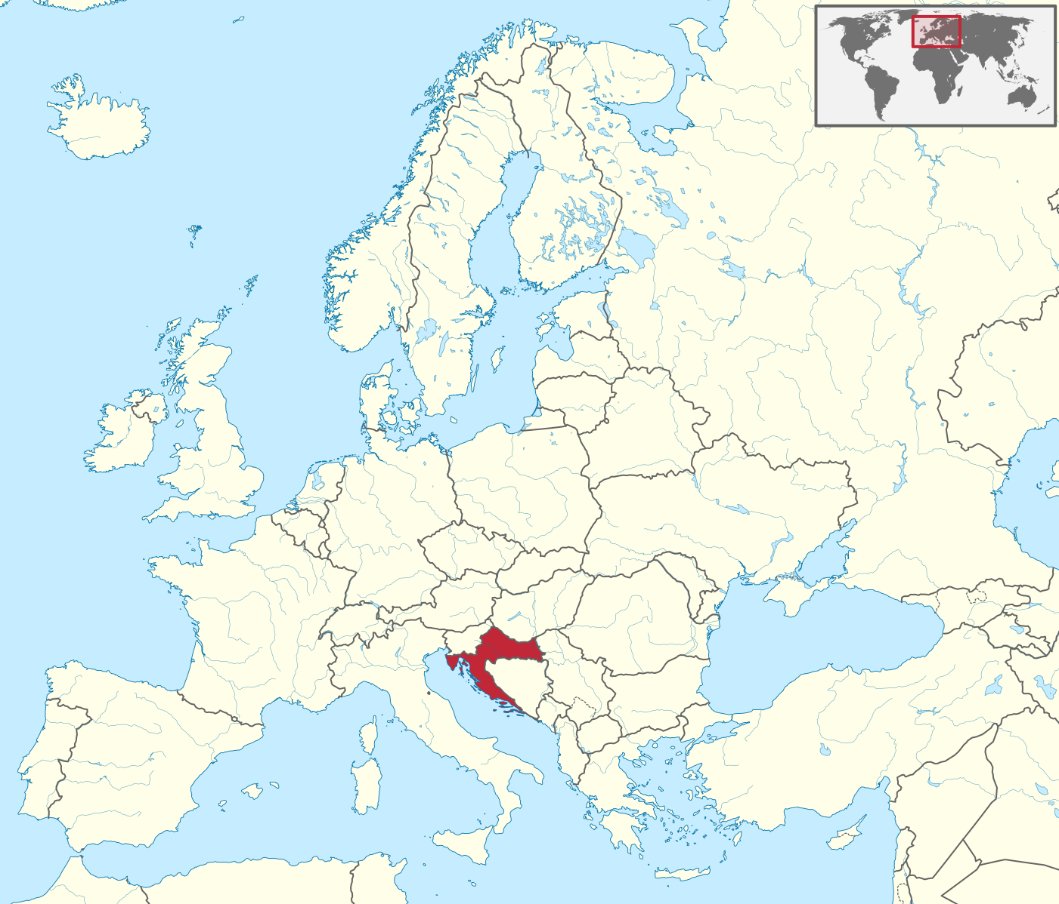
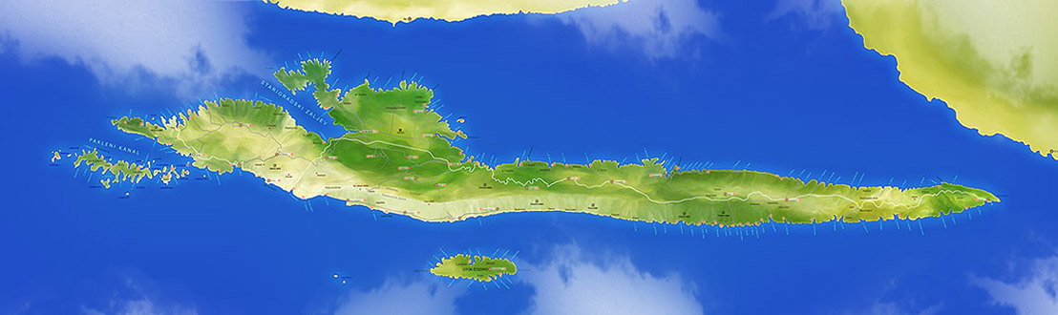
We are from Hvar, an island in Croatia

Slide 3
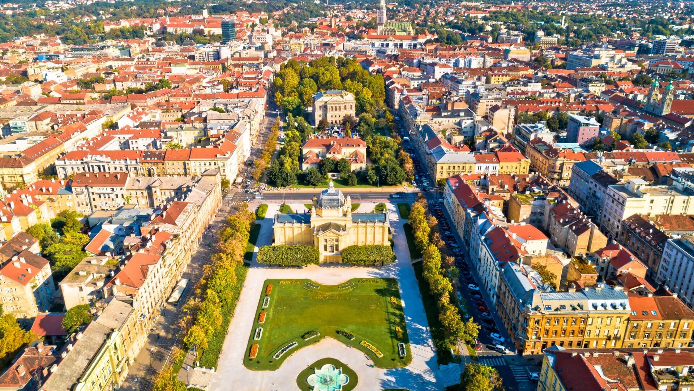
Croatia is a lovely country and Zagreb is our capital city:

Slide 4
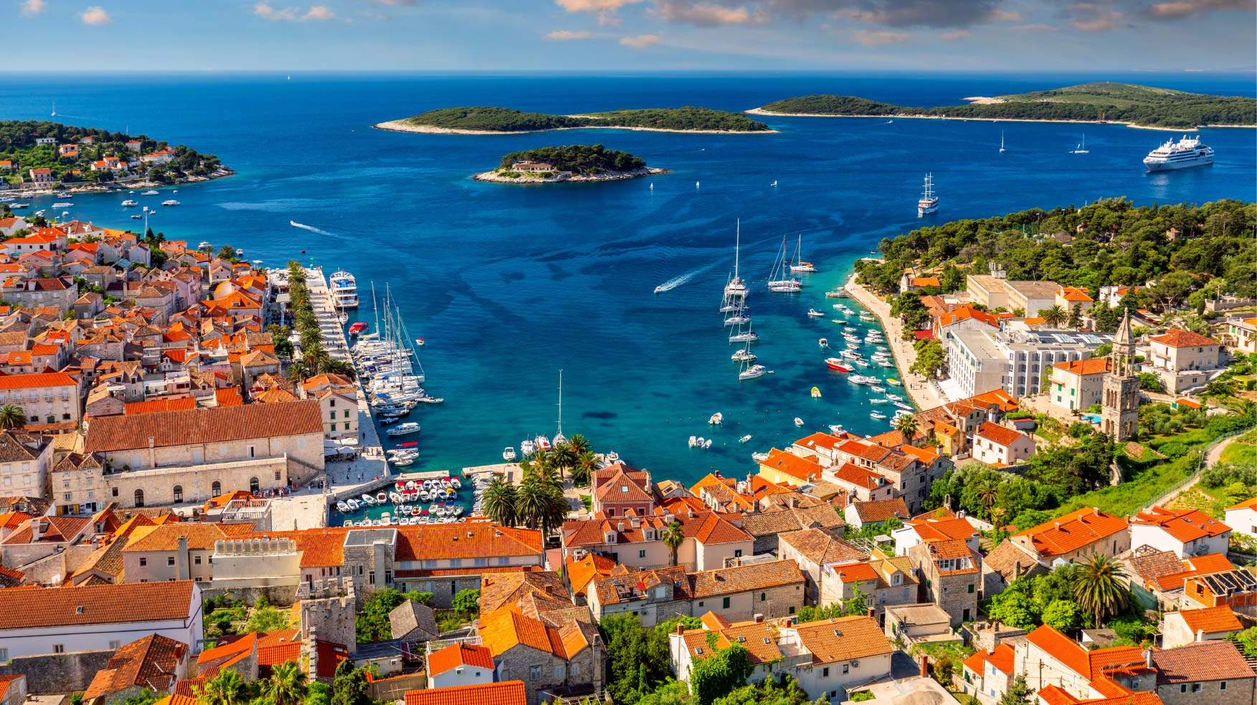
And this is the small, but lively city of Hvar:

Slide 5
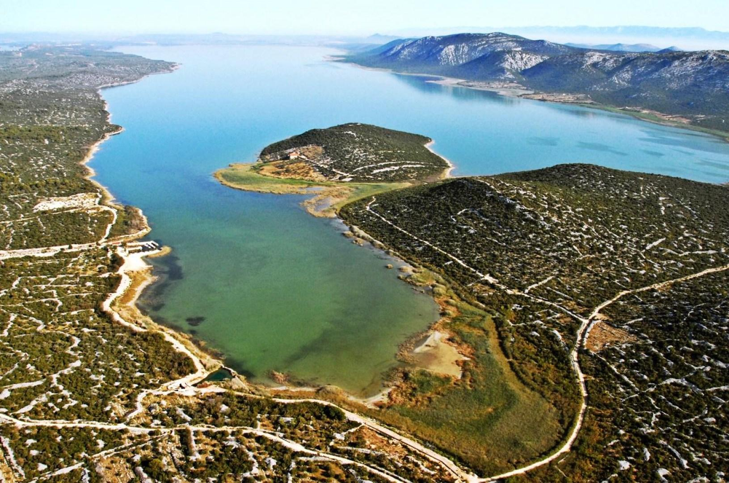
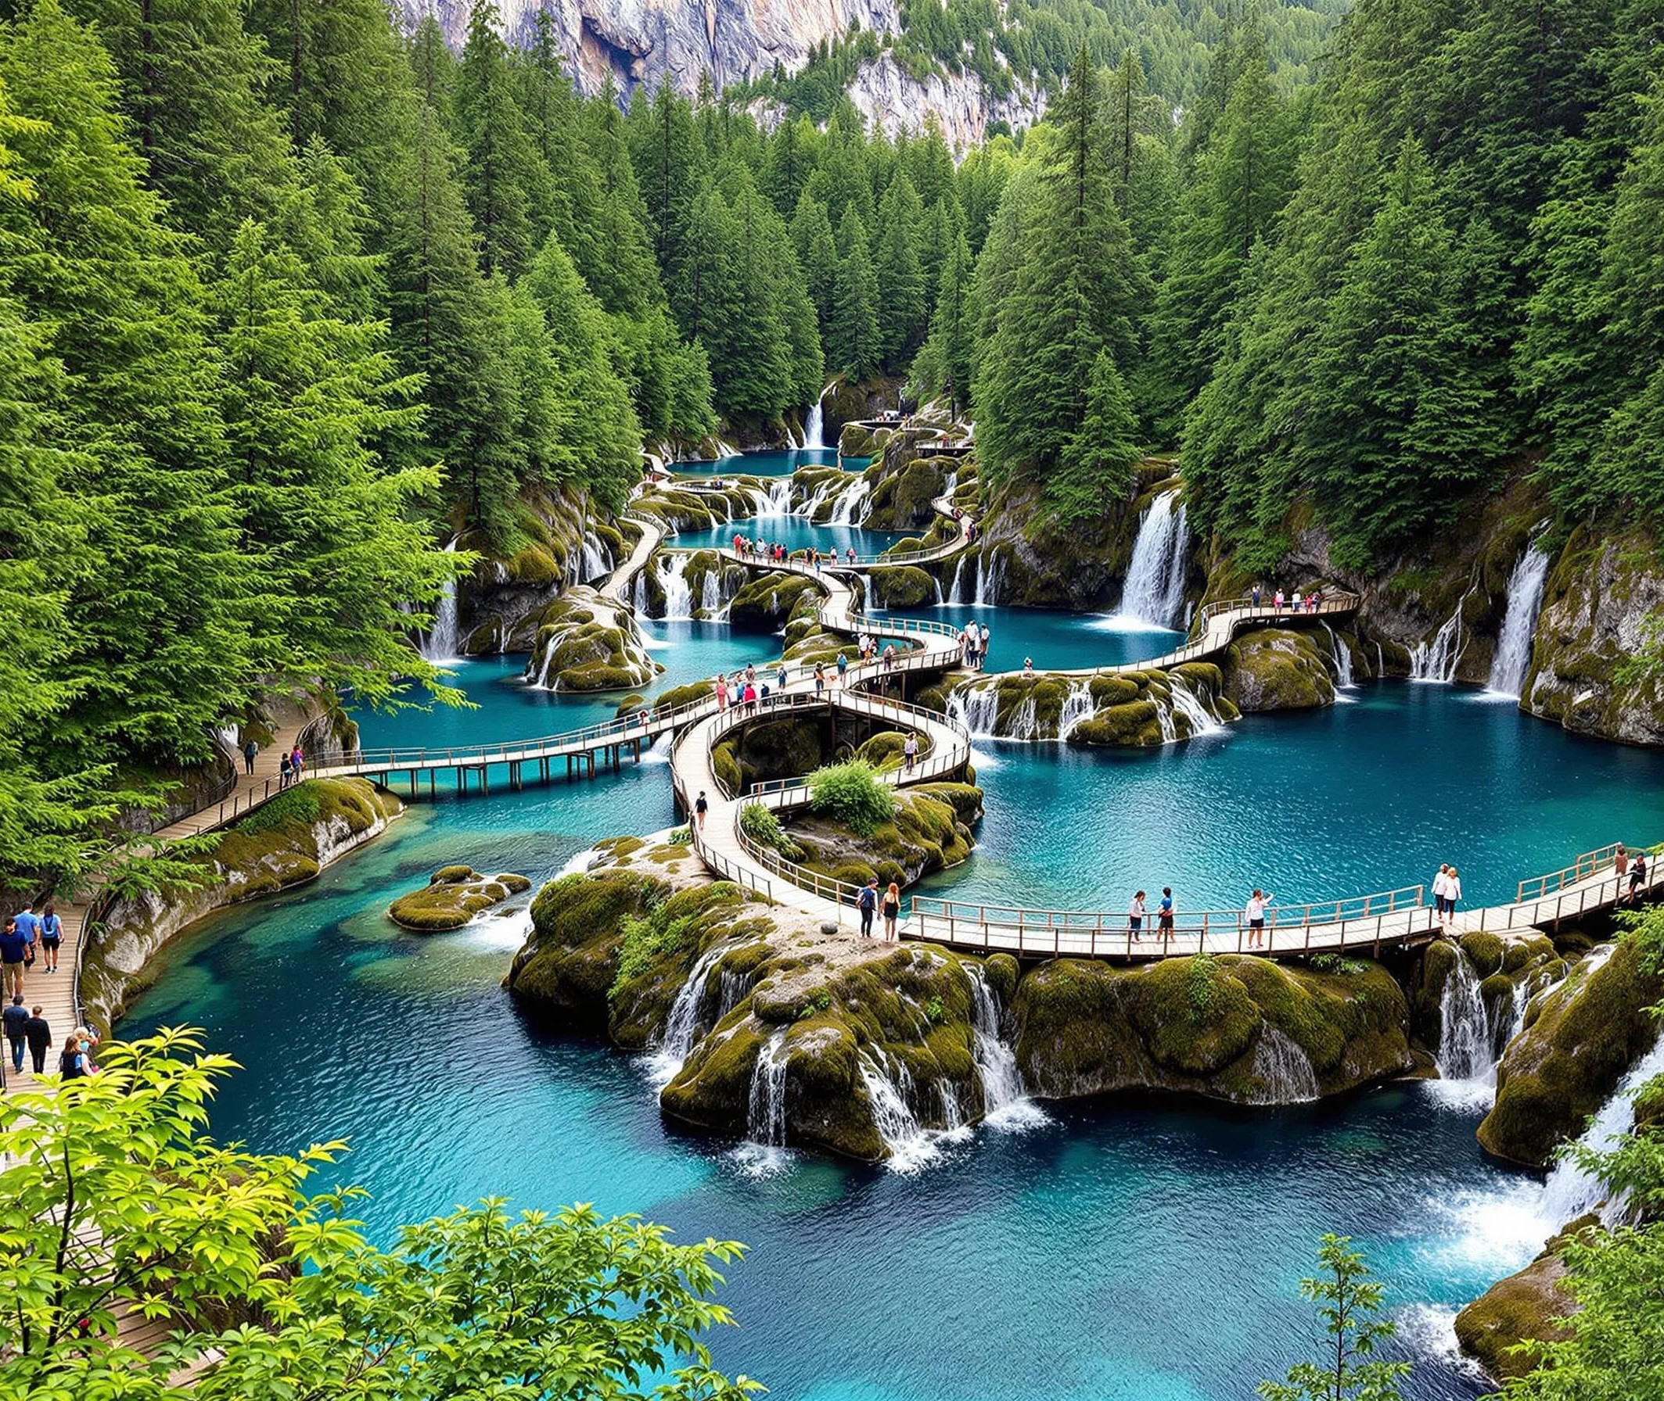
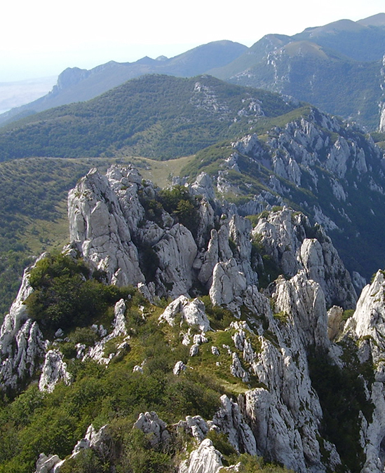
Croatia is rich with beautiful nature...
Mountain Velebit
Vransko jezero (lake)
Plitvice

Slide 6
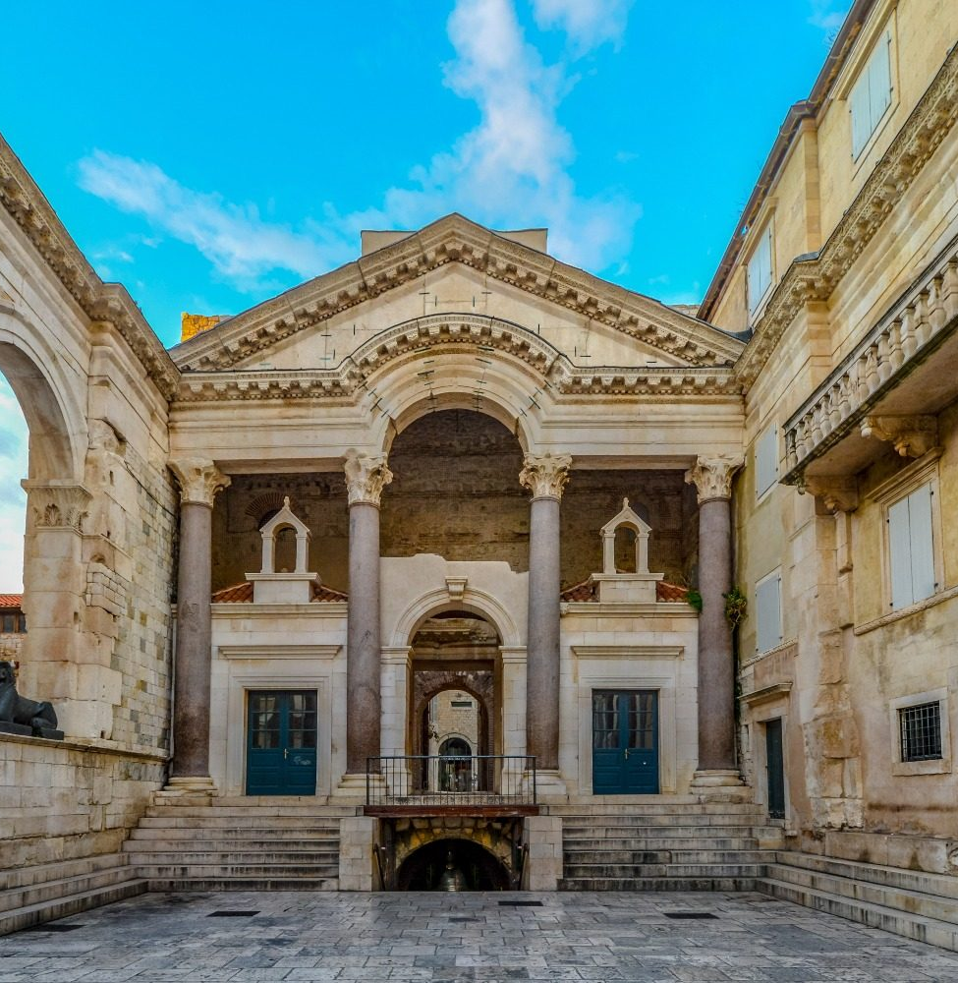
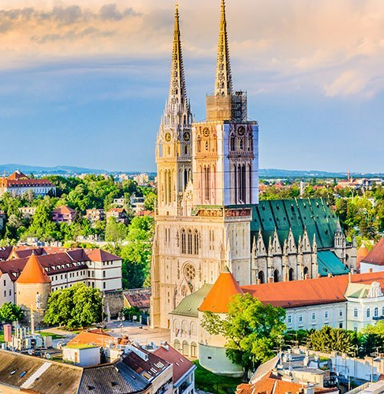
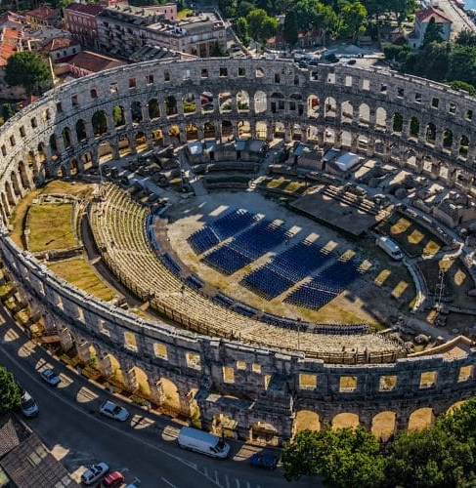
...and stunning architecture!
Diocletian's Palace in Split
Zagreb Cathedral
Pula Arena

Slide 7
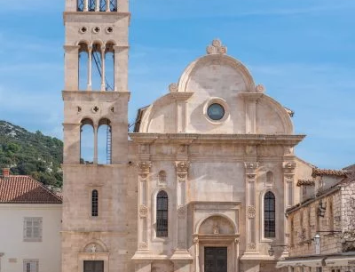
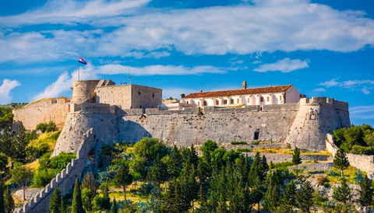
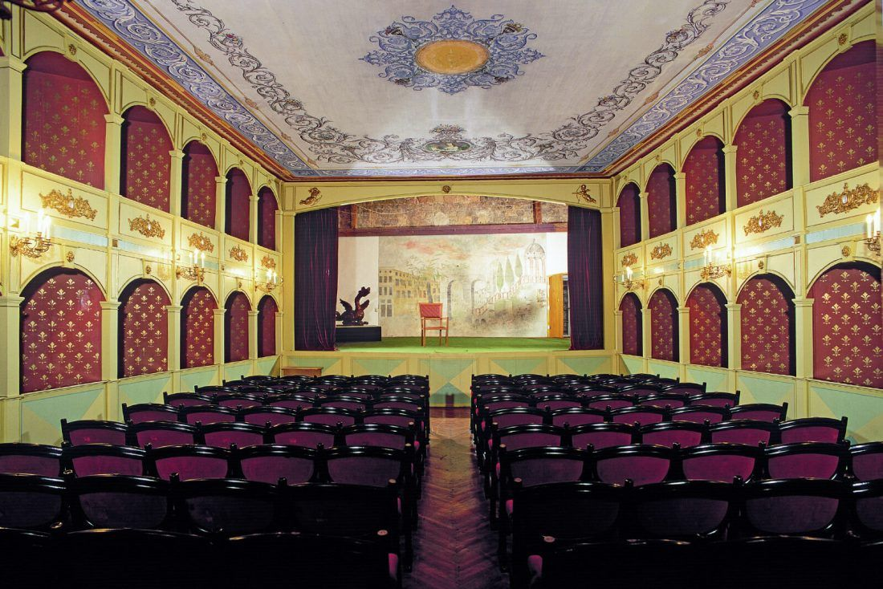
The city of Hvar isn't half-bad itself:
St. Stephen's Cathedral
Foretress Fortica
Hvar theatre

Slide 8
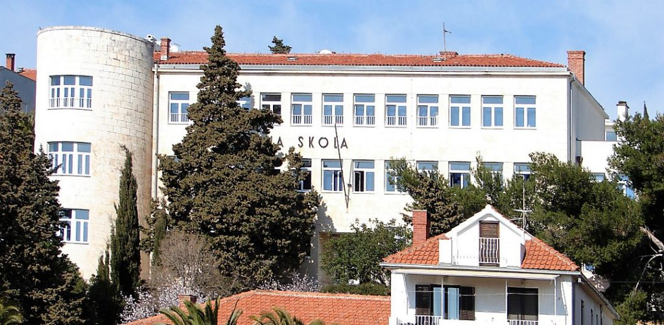
This is the Elementary School of Hvar
In addition to being an elementary school, Hvar Elementary School is also a high school with the opposite schedule from elementary school students.

Slide 9
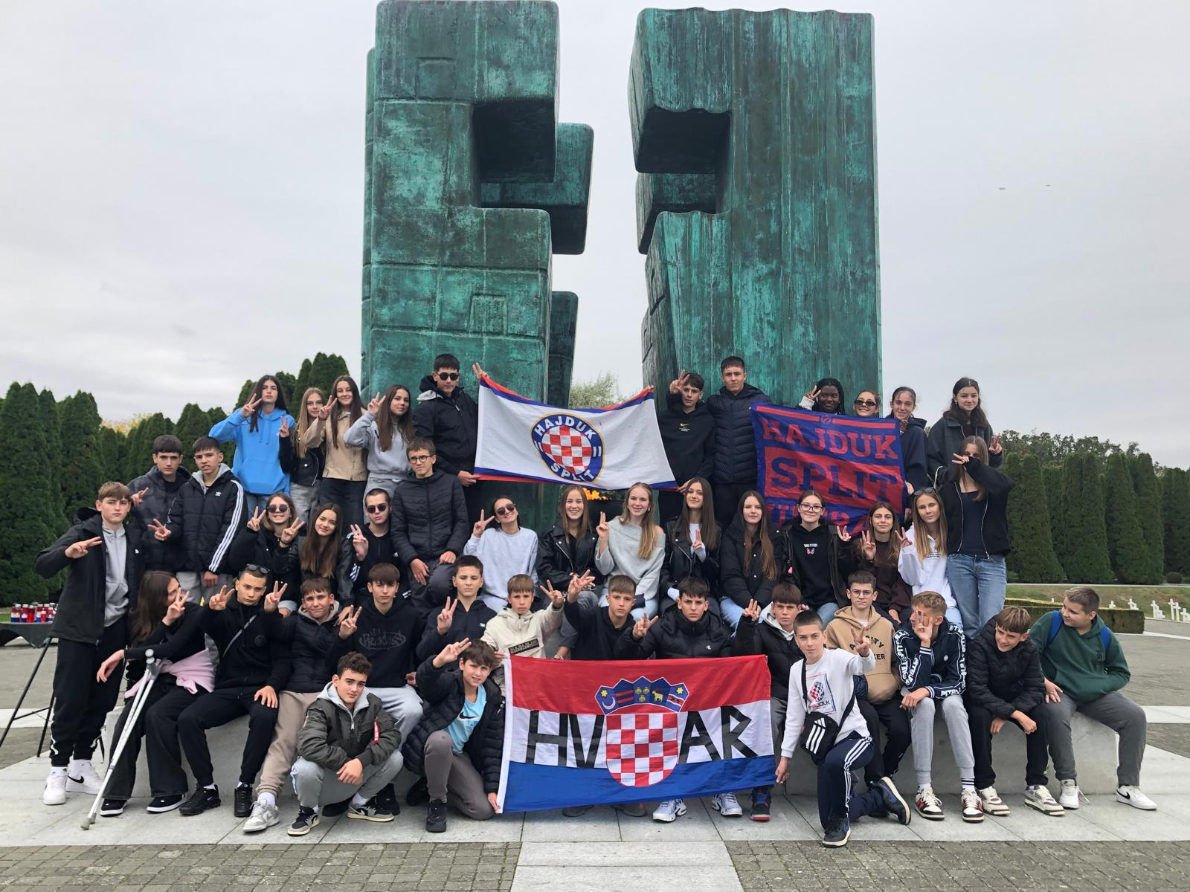
Introducing class 8.a!
We are a class with 21 children, 10 girls and 11 boys
In this picture, there are some students from class 8.b ^

Slide 10
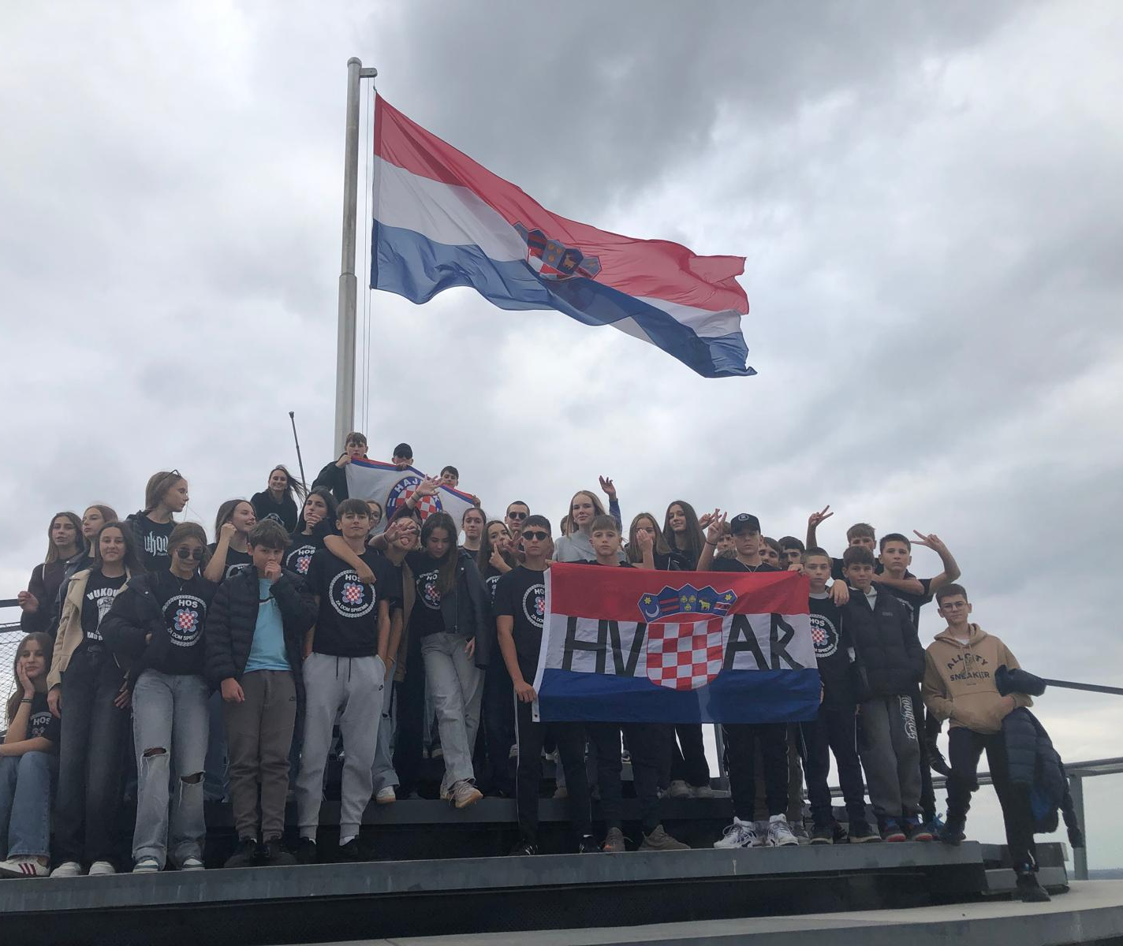
More about us:
Our favourite subjects are PE, Maths, Physics and of course... lunch break!

Slide 11

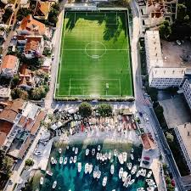

Shared activites
We are a rather sporty class. Most students either plays handball or football

Slide 12

It's a pleasure being partners with you!
"We're waving to you all the way from Hvar!"
8.a class

