Slide 1







Pozdrav Osnovna škola Hvar!
Digital
Bookmark Exchange Project
We are class 8.a! Greetings for you from Hungary, Gyöngyös!

Slide 2


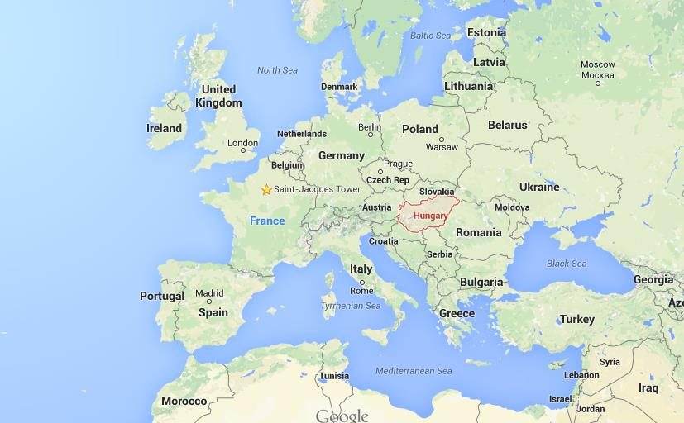


We live in Europe, in Hungary…

Slide 3

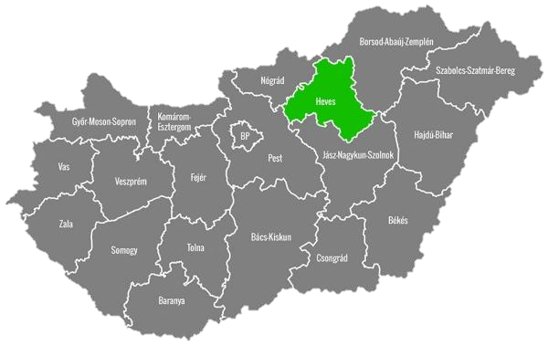
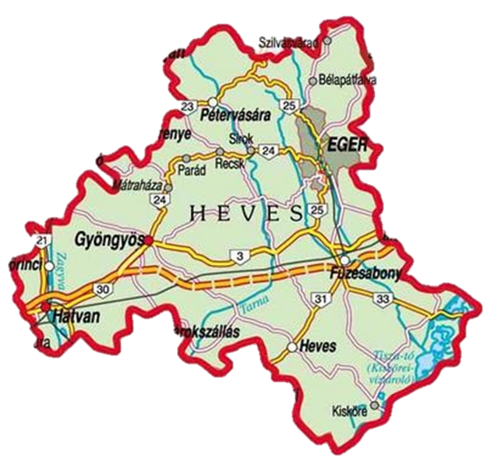

…in Heves county,…

Slide 4





…in Gyöngyös city!

Slide 5

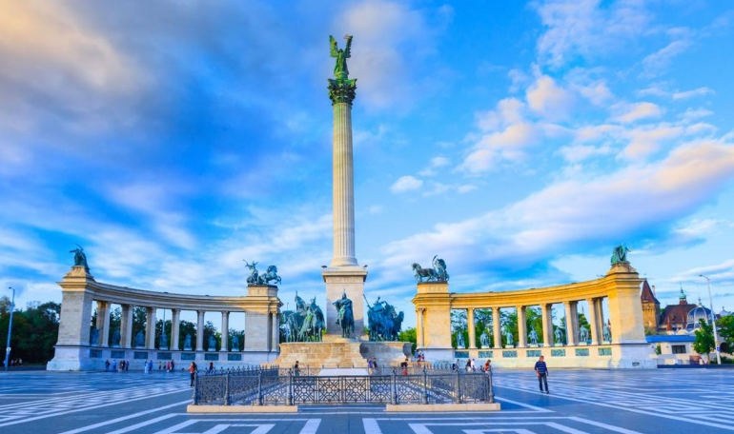
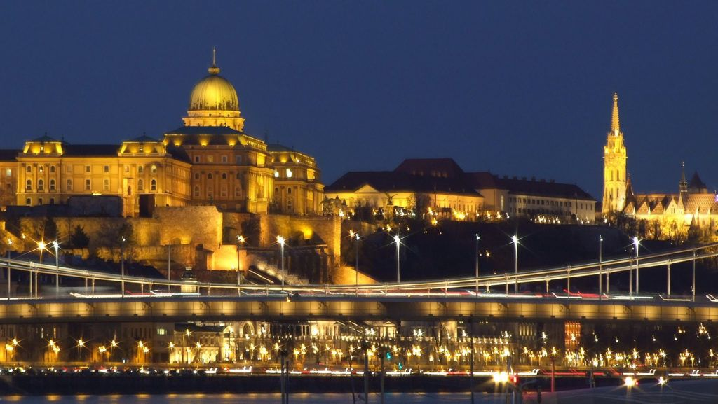
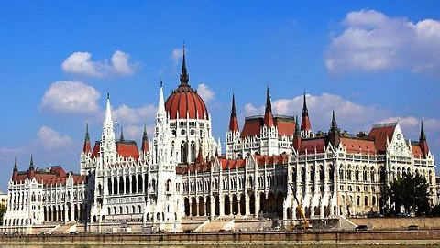

Hungary is a very beautiful country. Budapest is our capial city.
Heroes' Square
The Buda Castle
The Houses of Parliament

Slide 6
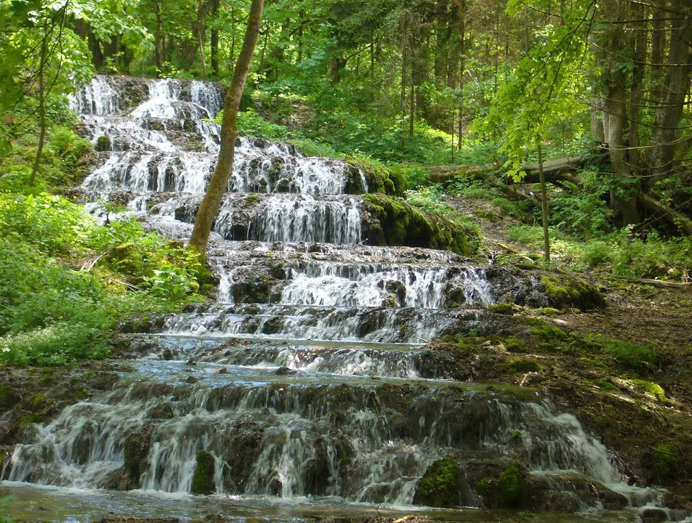
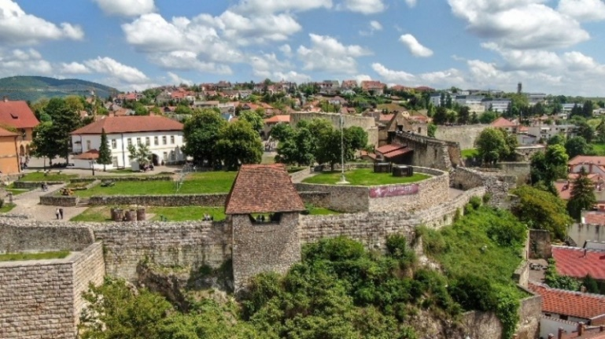
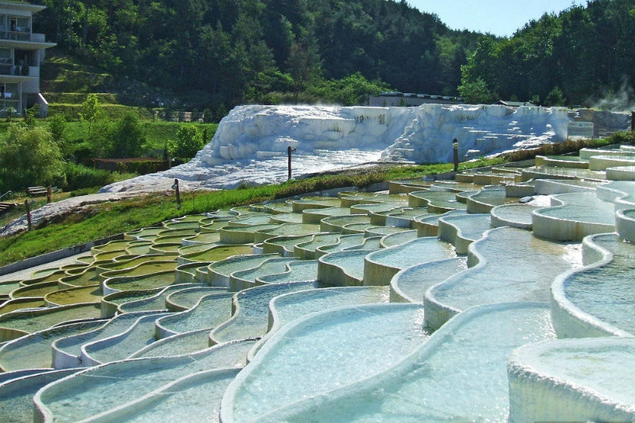


We have a lot of nice places in the north-east of Hungary where we live.
Veil waterfall of the Szalajka-valley
City of Eger –
The capital city of Heves county.
Salt hill of Egerszalók

Slide 7

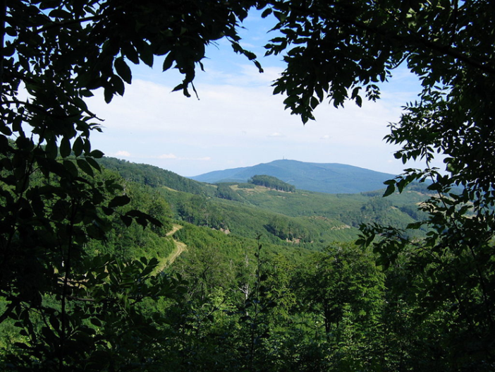

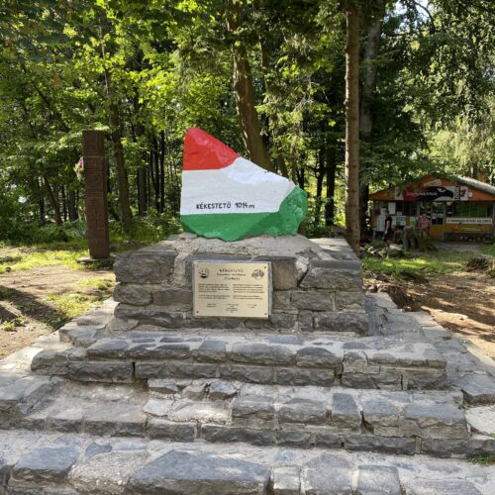
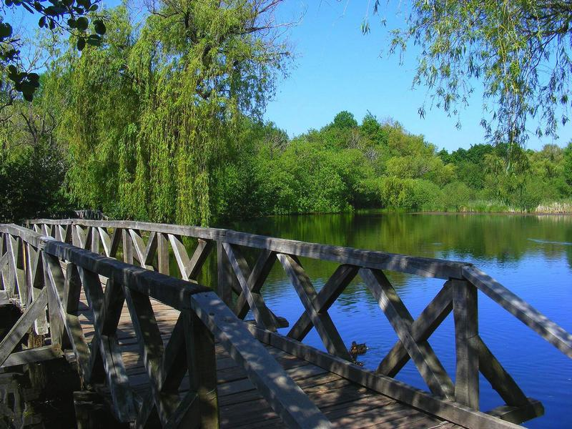
The Mátra mountain,
Kékestető, the highest point of our country. (1015 m)
Sástó Lake

Slide 8

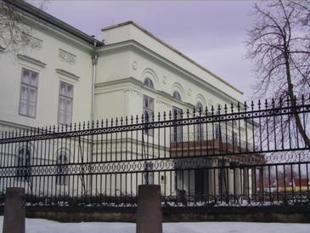

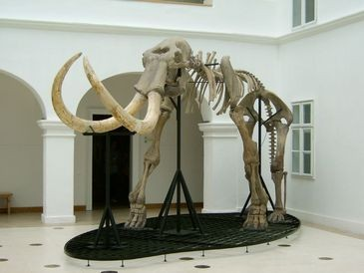

And of course Gyöngyös city, too:
Mátra Museum
Orczy Castle

Slide 9
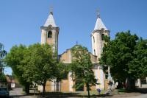
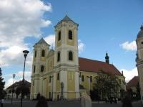
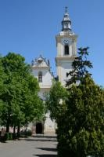
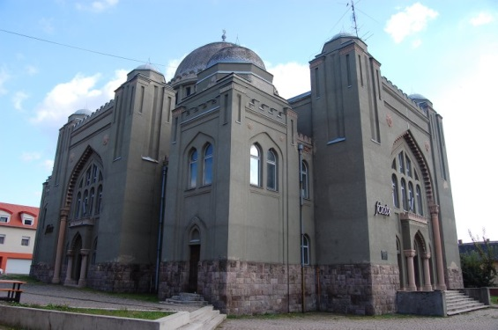
Saint Orban Church
Saint Bertalan Church
Franciscan Parish Church
Gyöngyös Synagogue

Slide 10



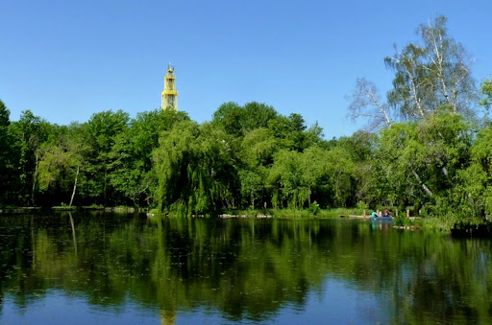
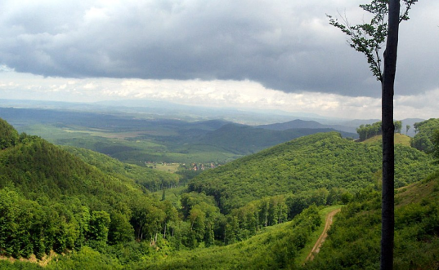

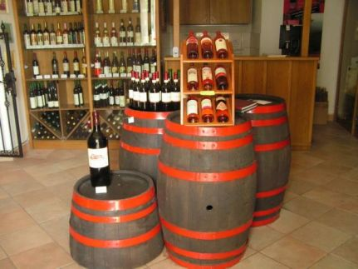
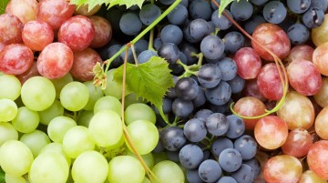
… was first mentioned in writing in 1261.
Gyöngyös the gate of Mátra and is about 80 km from Budapest, the capital of Hungary.
In 1987 it received the title of International Town of Grapes and Wine.

Slide 11
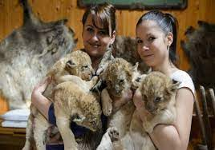
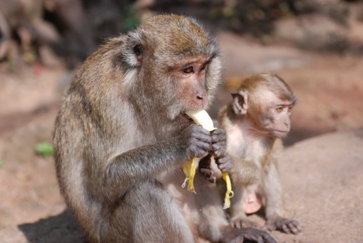
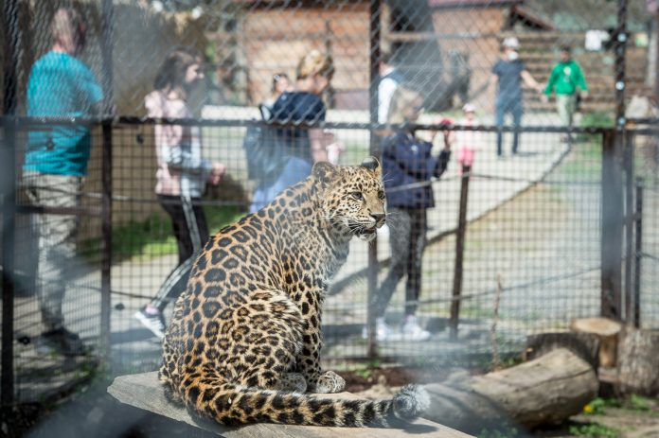


Gyöngyös Zoo,

Slide 12


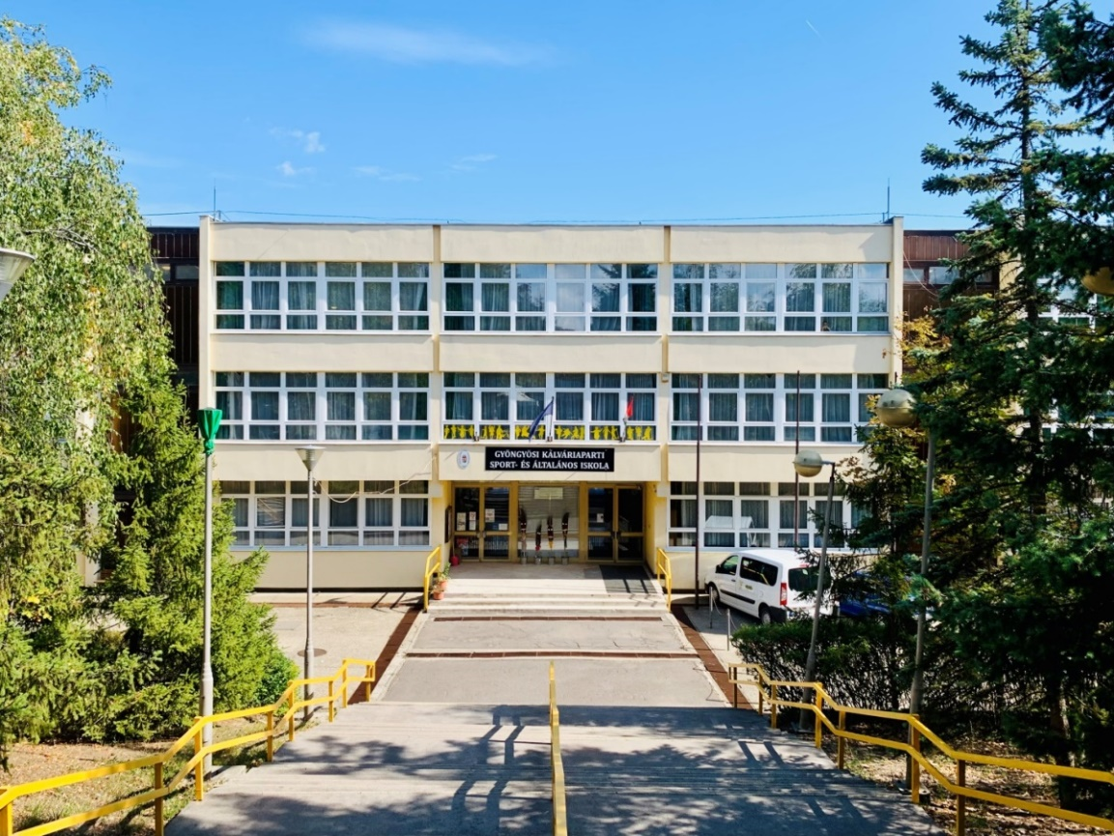

This is our school: the Gyöngyösi Kálváriaparti Sport- and
Primary School!
Our school is one of the primary education institutions in Gyöngyös.
In addition to the primary school classes with a normal curriculum, children wishing to play sports can study in special sports classes with us.

Slide 13
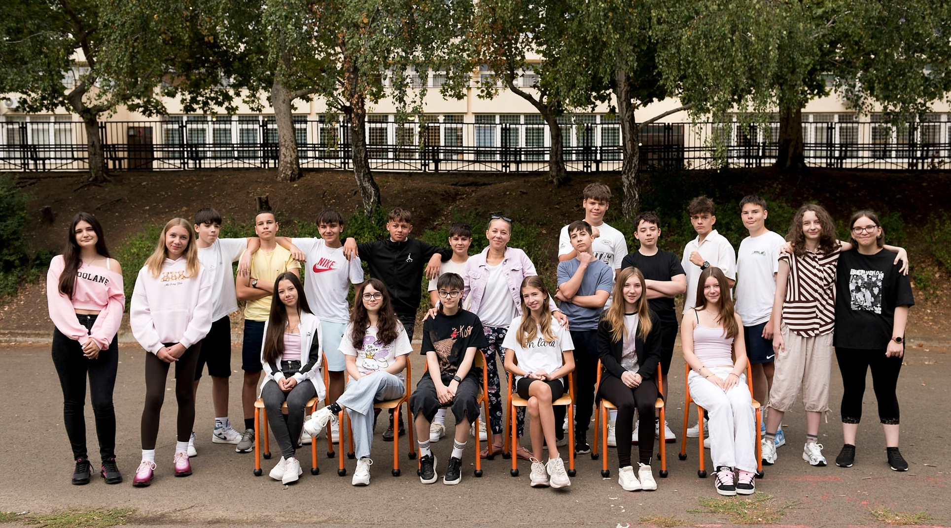
Introducing Class 8.a
Number of students:
23 (11 girls, 12 boys)
Class teacher:
Nóra Bágyi

Slide 14
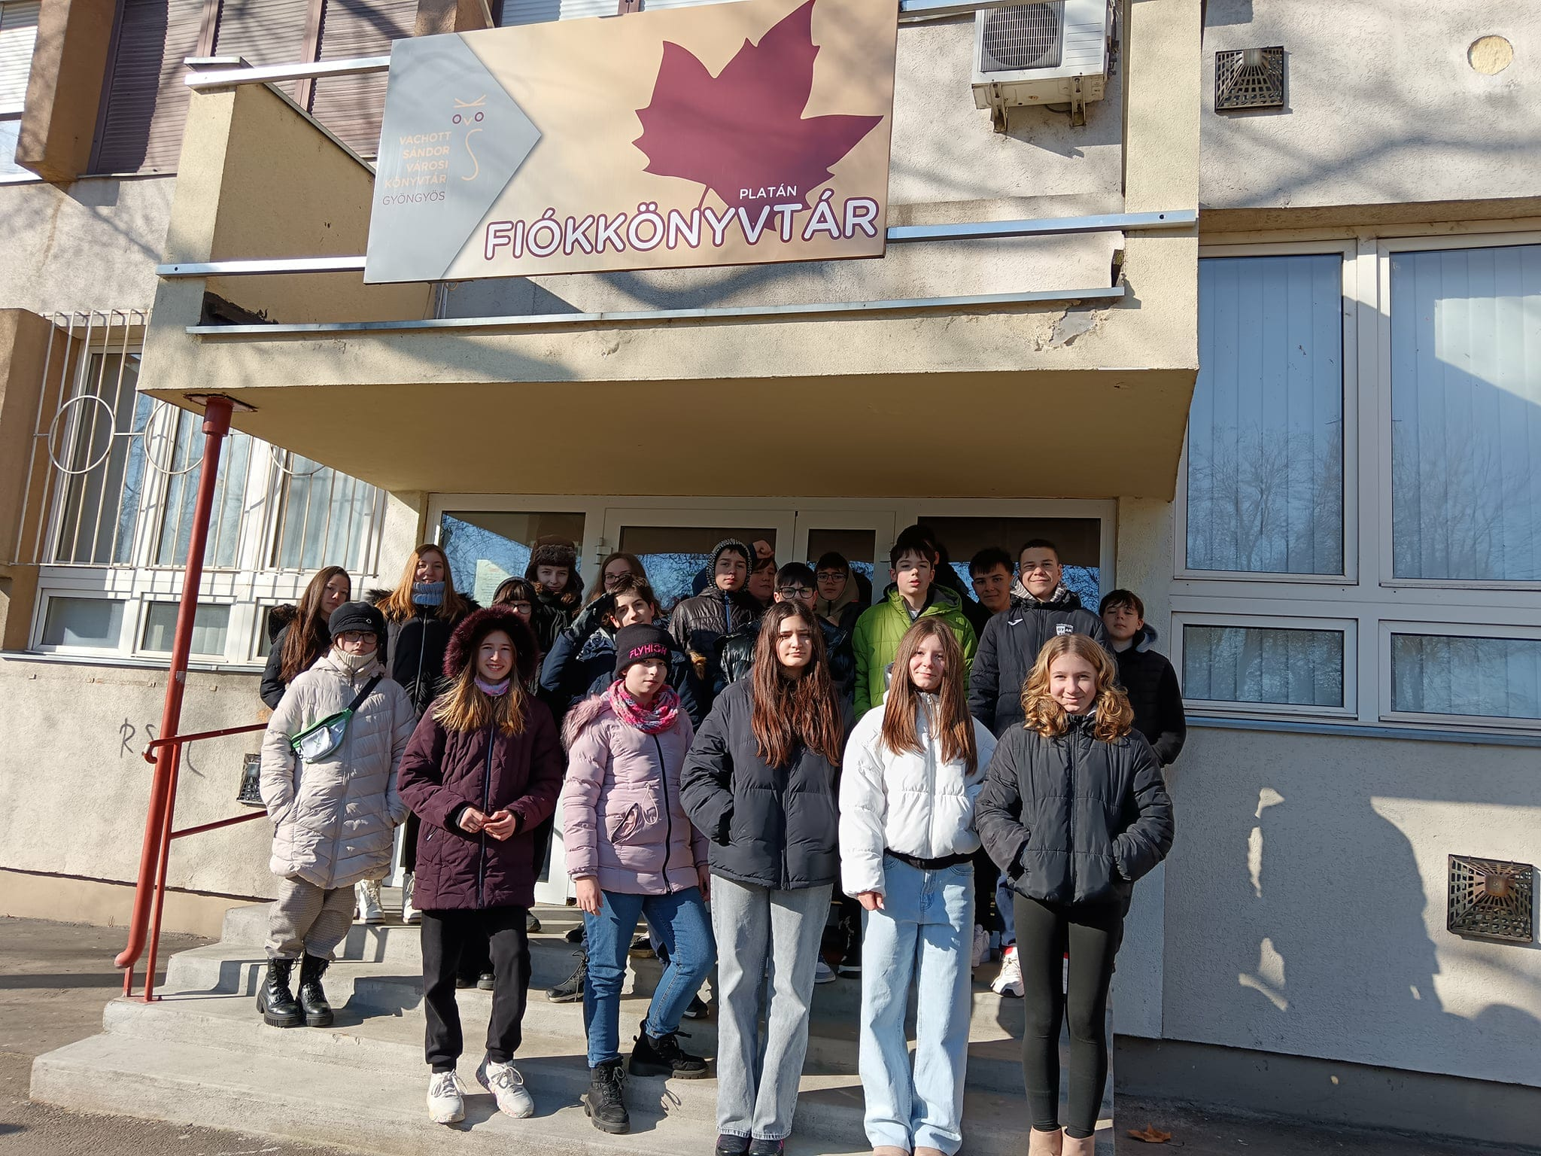
About Our Class
Favourite subjects:
Biology, Physical Education,
English

Slide 15
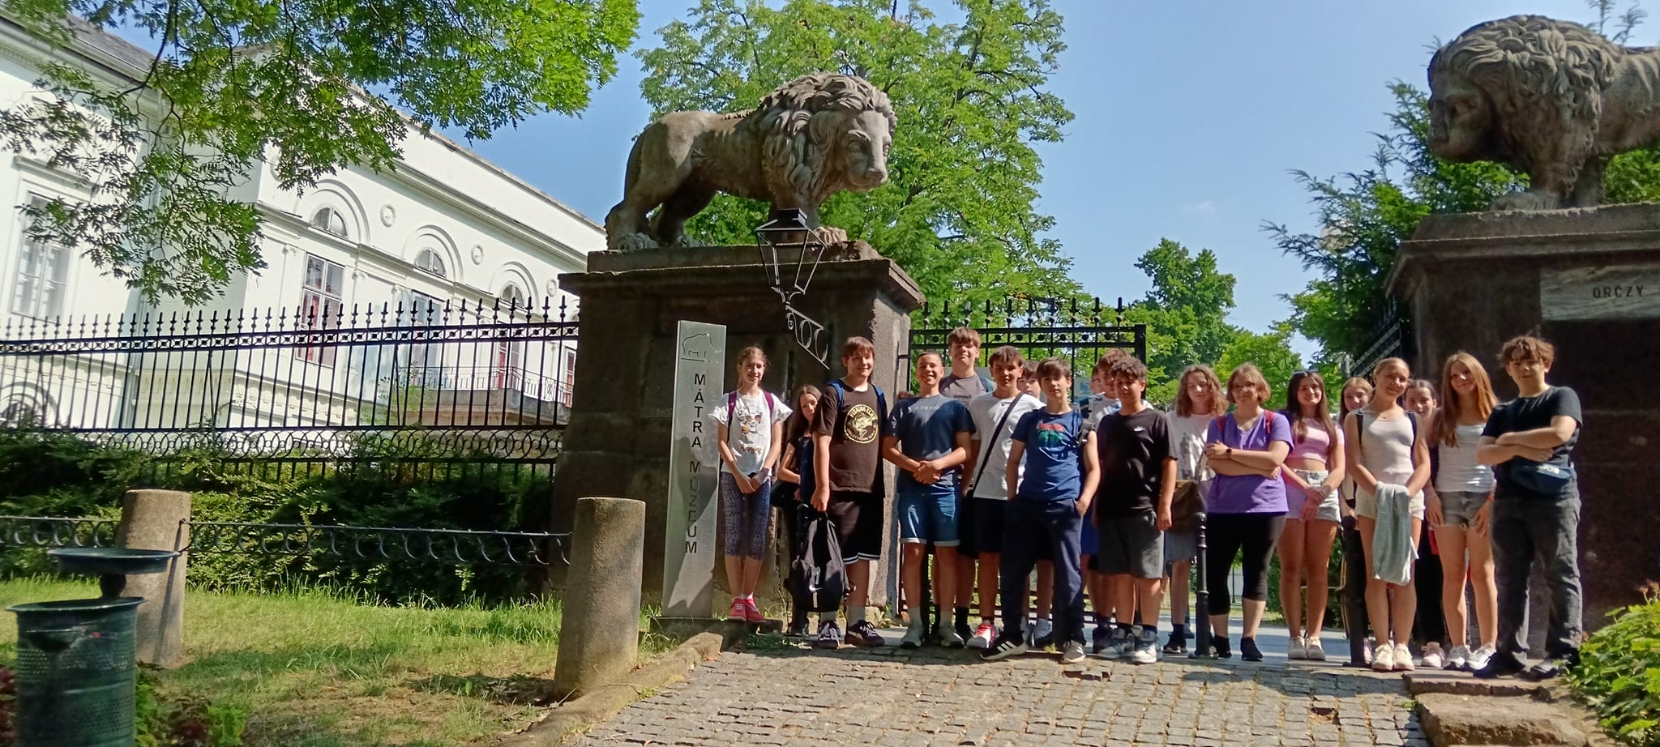
Our Shared Programs
Favourite activities together:
Quad biking, Football, Hiking, Reading

Slide 16
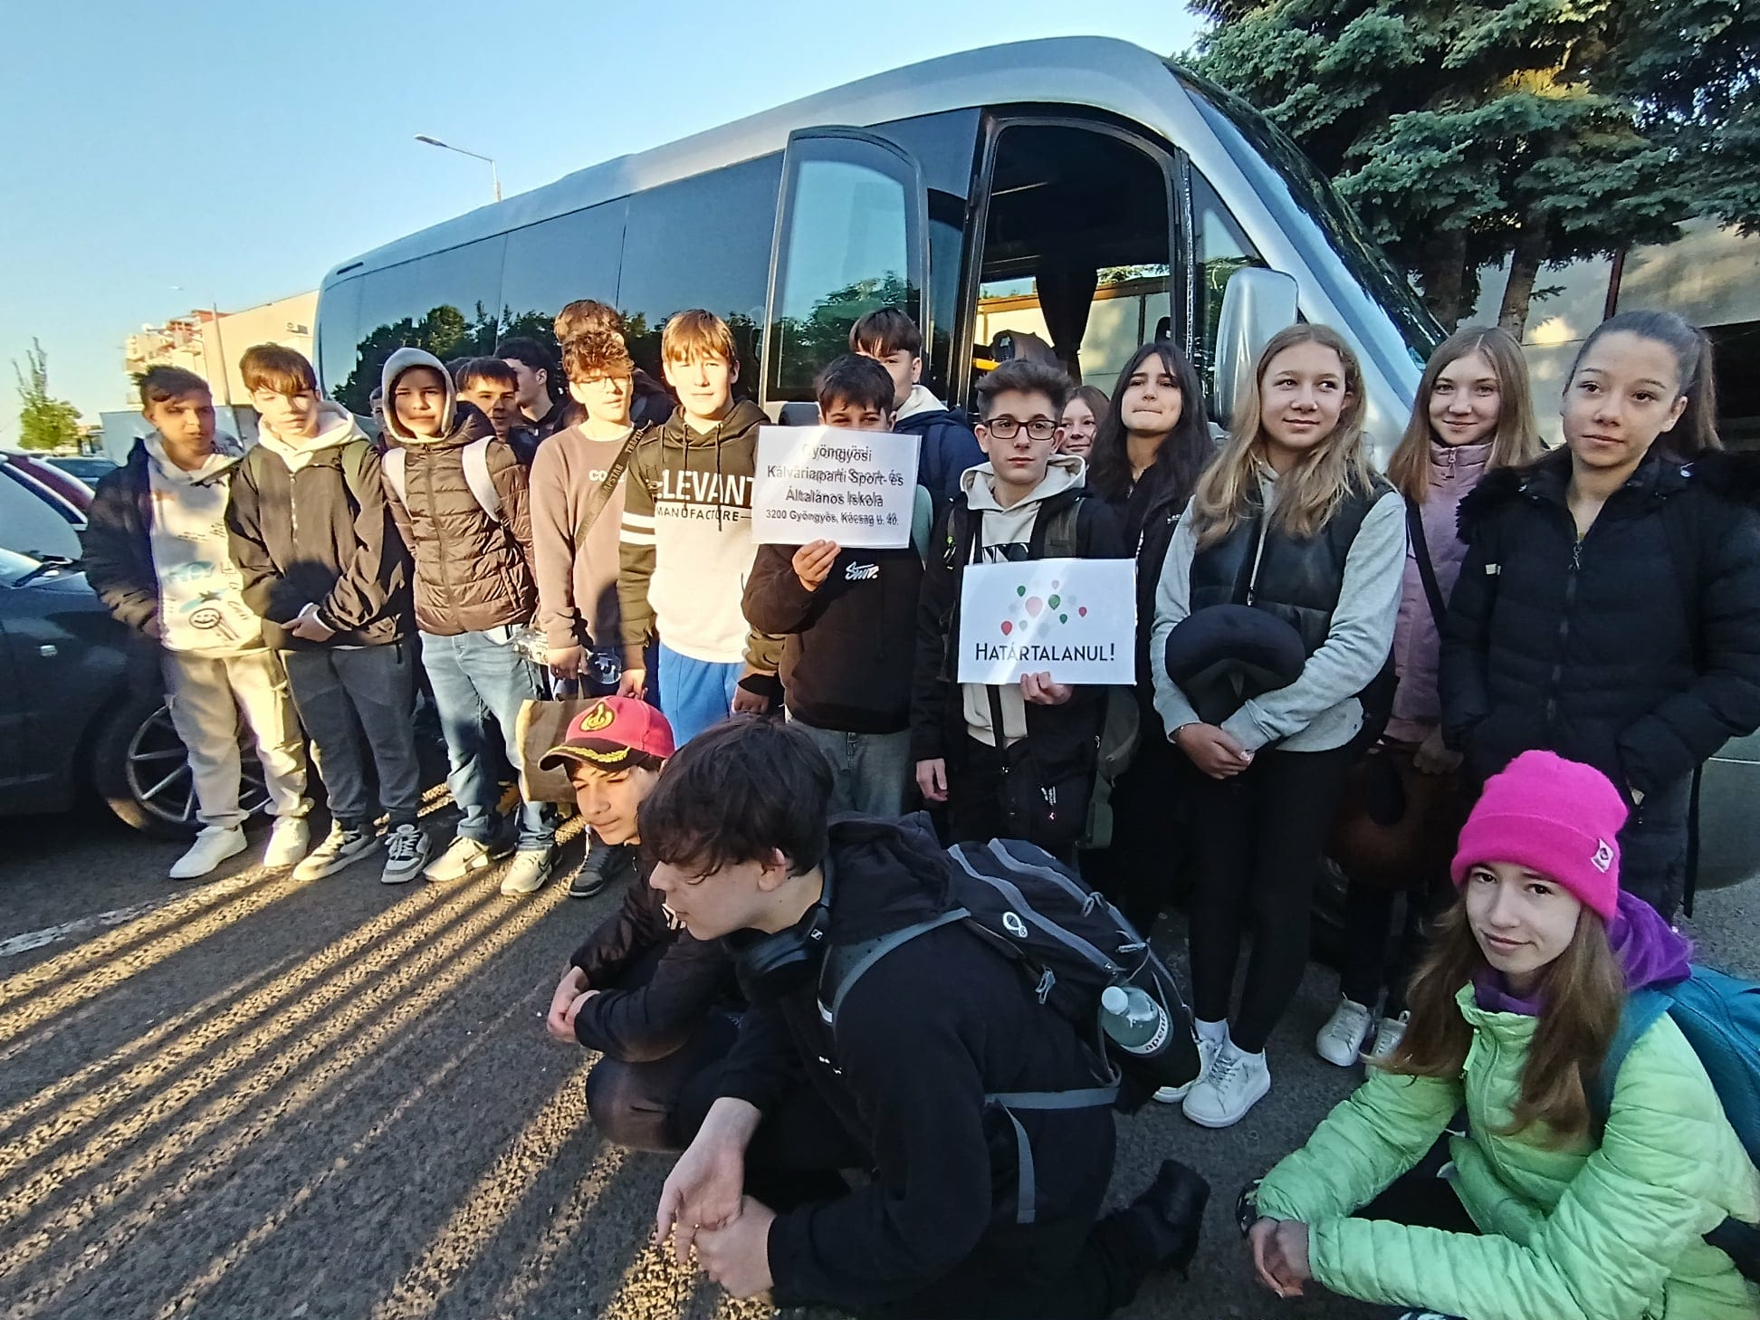
Our Shared Programs
Why Do We Love Kálvária?
Sports opportunities,
Friends, Library,
“Határtalanul” international program,
Active programs,
Erasmus,
Language learning 🗣️

Slide 17

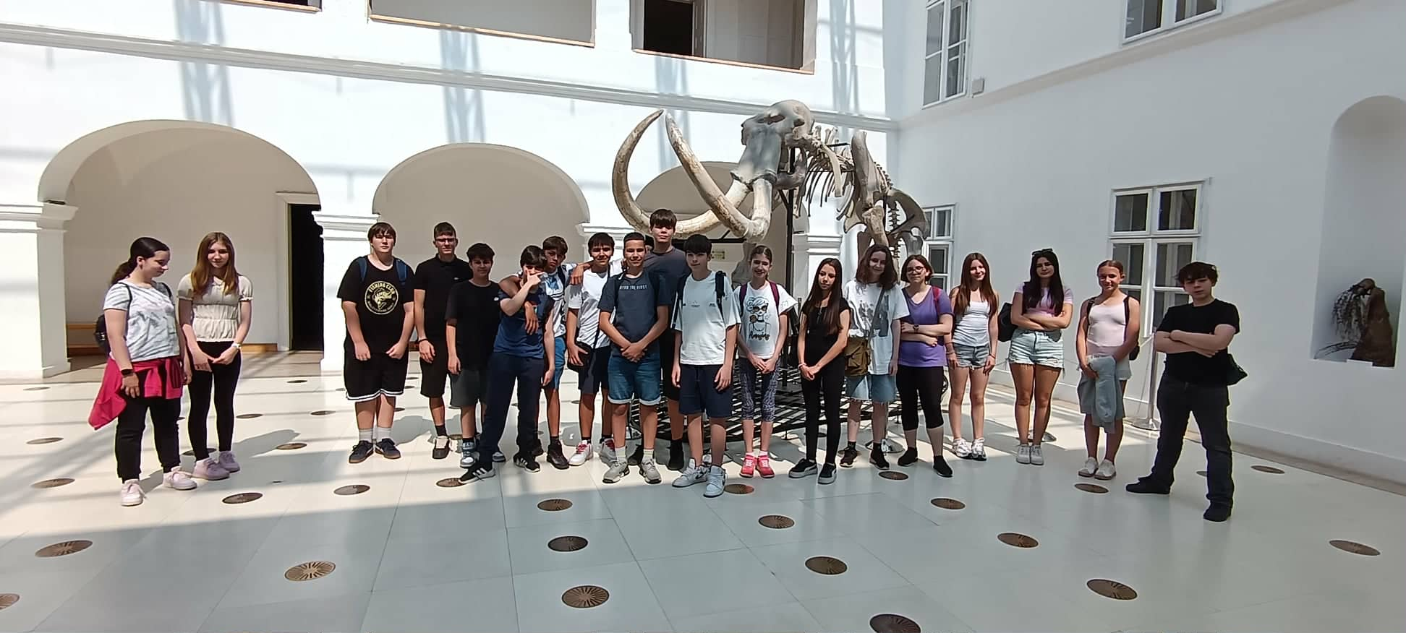
Message to Our Partner School
https://kalvariaiskola.hu/
“We are sending you a smile from Kálvária School with love!”

